Slide 1

Clinical Problem-Solving
Closing the Gap
Colin H. McLeish, M.D., M.B.A., Allan C. Gelber, M.D., Howard M. Lederman, M.D., Ph.D., Michael J. Chilazi, M.D., and John A. Woller, M.D.
N Engl J Med
Volume 394(1):79-85
January 1, 2026

Slide 2
Summary
A 31-year-old woman presented with 10 days of fever, sinus pressure, cough, nausea, and vomiting.
Three episodes of similar symptoms, as well as night sweats, fatigue, and weight loss, had occurred in the previous 5 months.

Slide 3
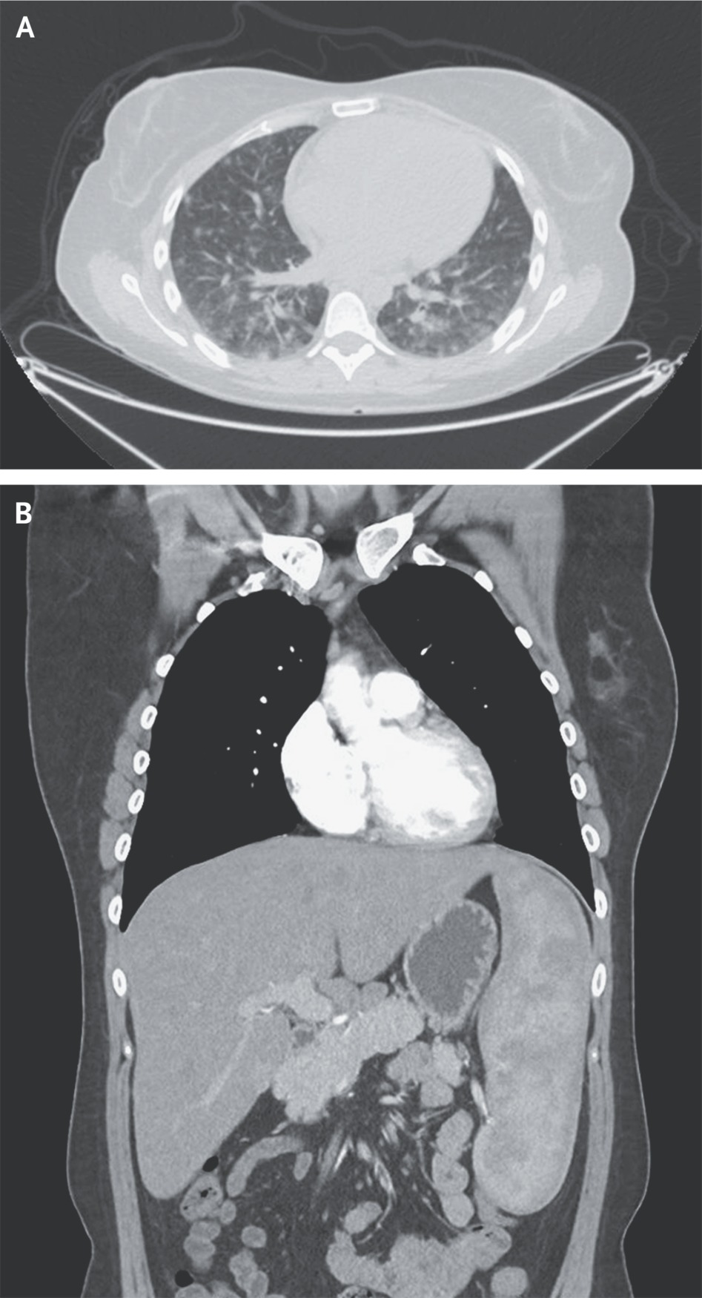
Imaging Studies of the Chest.
McLeish CH et al. N Engl J Med2026;394:79-85
Notes:
Figure 1 Imaging Studies of the Chest. An axial computed tomographic scan of the chest shows bilateral pulmonary nodules of varying size in the perilymphatic and peribronchovascular distribution (Panel A); a coronal view shows hepatomegaly and splenomegaly (Panel B).

Slide 4
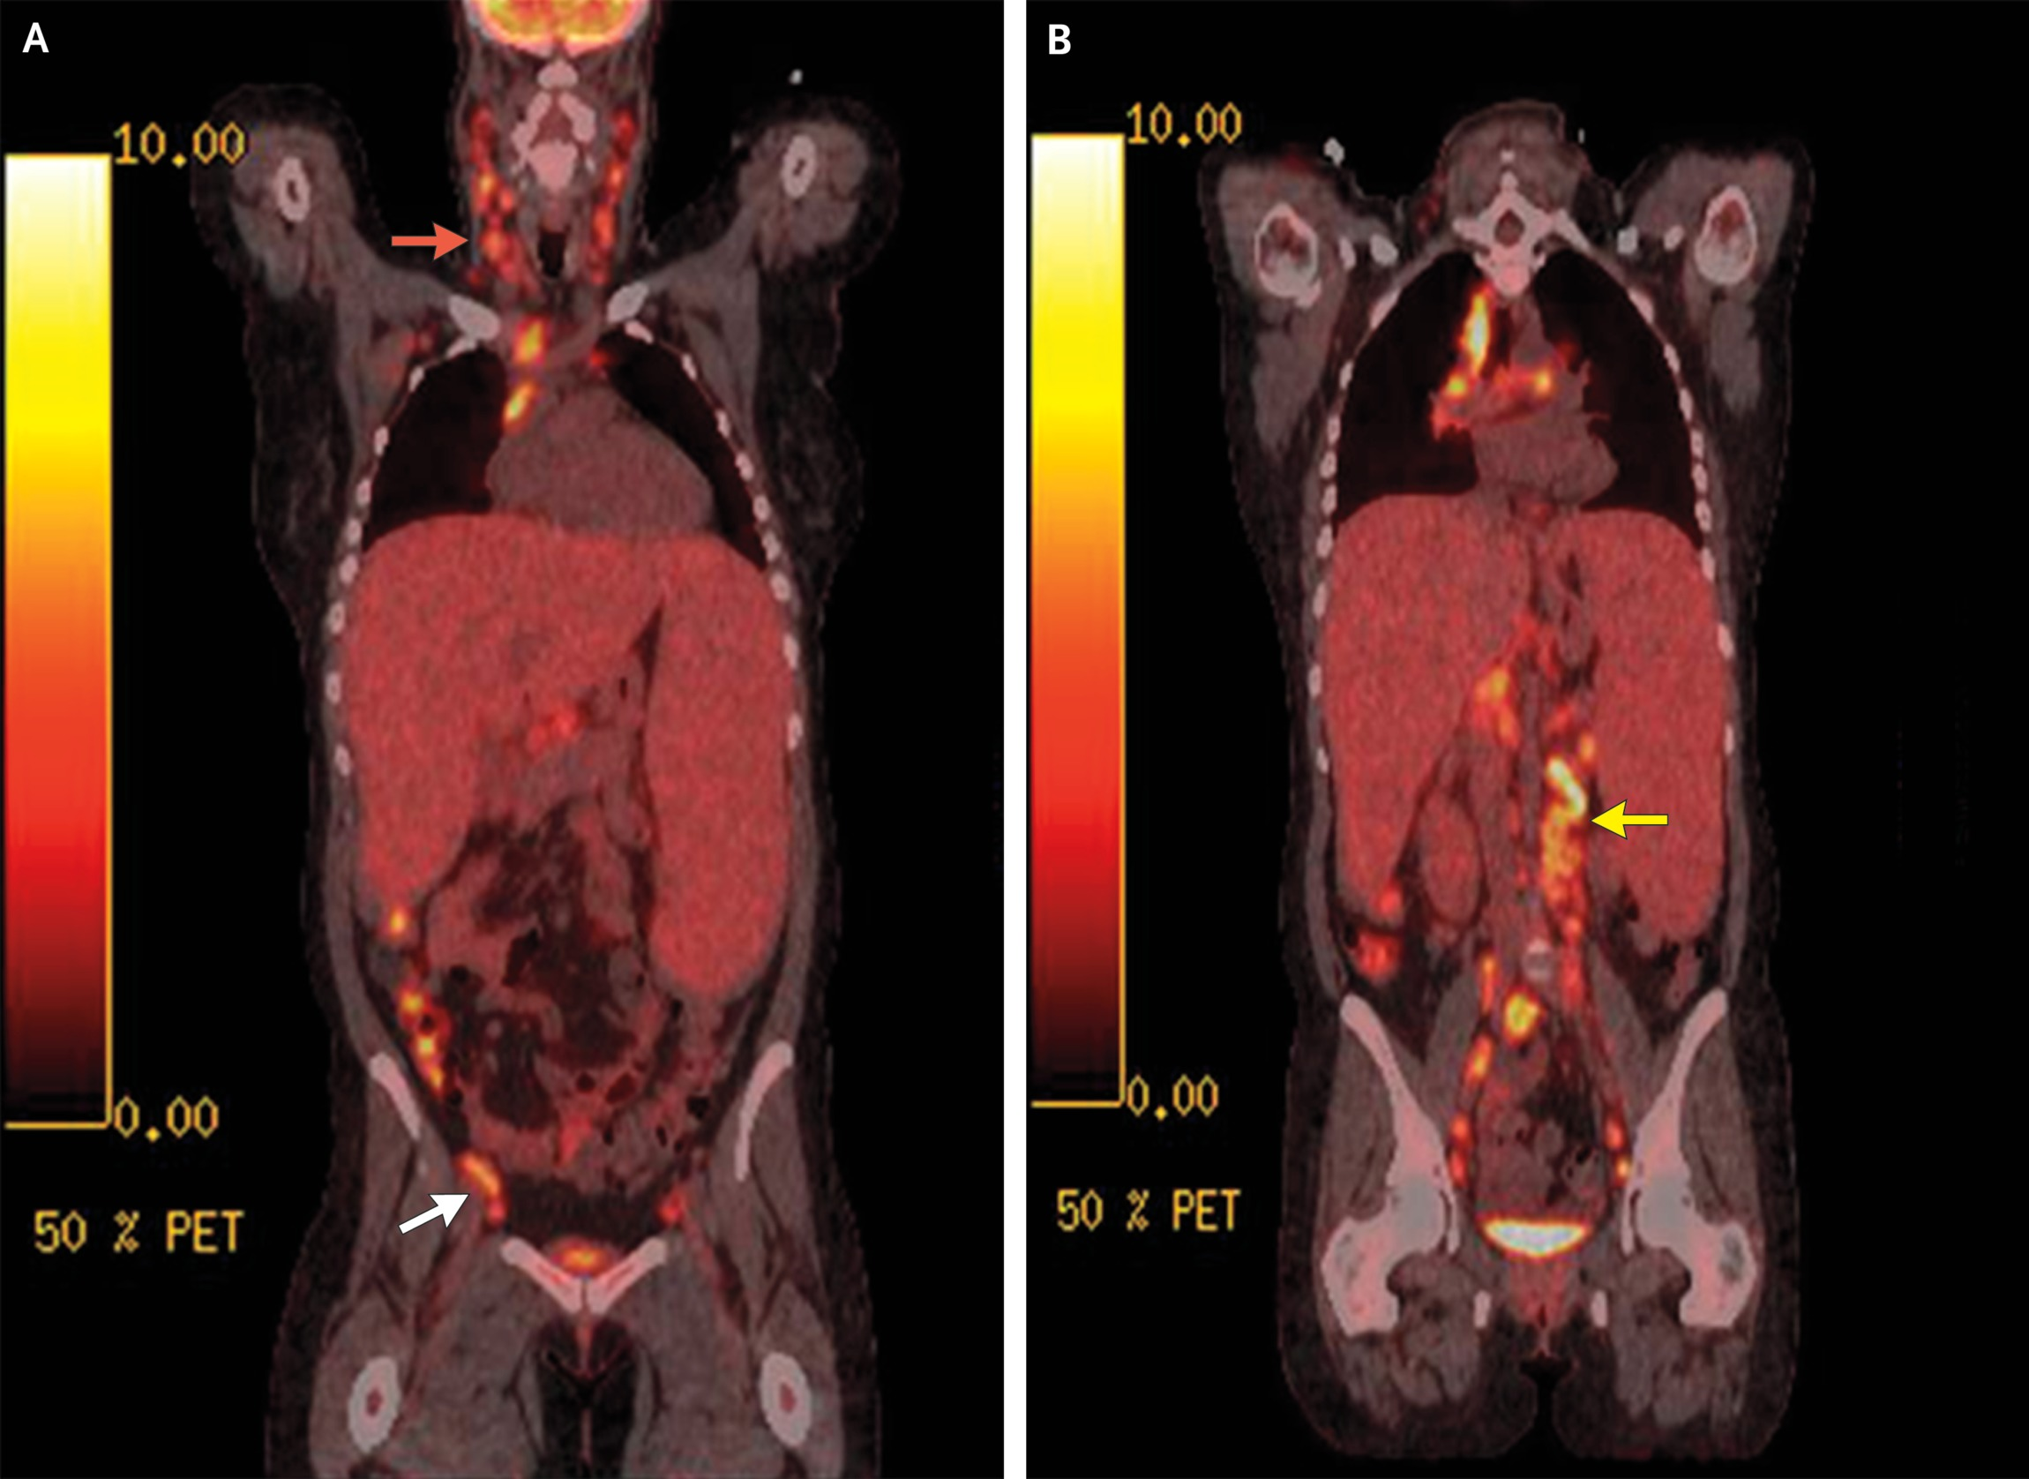
Imaging Studies from the Skull Base to Mid-Thigh.
McLeish CH et al. N Engl J Med2026;394:79-85
Notes:
Figure 2 Imaging Studies from the Skull Base to Mid-Thigh. A coronal positron-emission tomographic–computed tomographic scan shows bulky, ¹⁸F-fluorodeoxyglucose–avid lymphadenopathy in the cervical (red arrow) and inguinal (white arrow) chains (Panel A), as well as the periaortic and retroperitoneal chains (Panel B, yellow arrow).

Slide 5
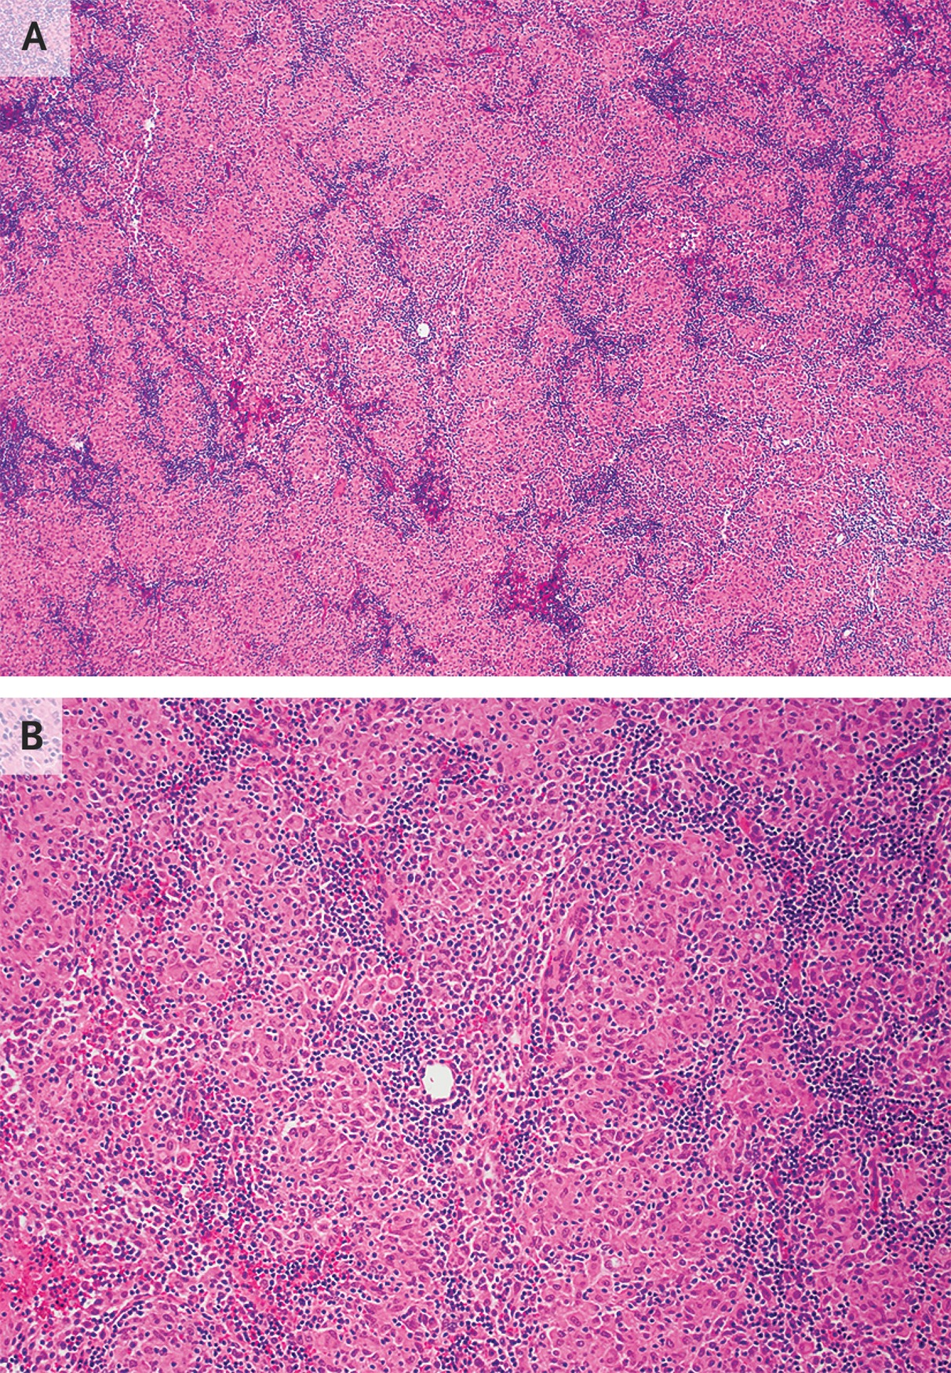
Histologic Examination of an Excisional Biopsy Sample of the Right Supraclavicular Lymph Node.
McLeish CH et al. N Engl J Med2026;394:79-85
Notes:
Figure 3 Histologic Examination of an Excisional Biopsy Sample of the Right Supraclavicular Lymph Node. Hematoxylin and eosin staining showed effaced lymph-node architecture by nonnecrotizing granulomatous inflammation (Panel A); the granulomas were small, compact, and comprised epithelioid histiocytes (Panel B, higher magnification). The histologic images were provided by Caroline Early, M.D.

