Slide 1

Clinical Problem-Solving
A Matter of Time
Grant A. Wilson, M.D., Colin H. McLeish, M.D., Allan C. Gelber, M.D., Natasha M. Chida, M.D., M.S.P.H., and Michael R. Rose, M.D., M.P.H.
N Engl J Med
Volume 394(6):589-595
February 5, 2026

Slide 2
Summary
A 29-year-old woman with active opioid, alcohol, benzodiazepine, tobacco, and cocaine use disorders and recent intravenous drug use presented with acute onset of chills and increased pain and drainage of chronic wounds in both legs.

Slide 3
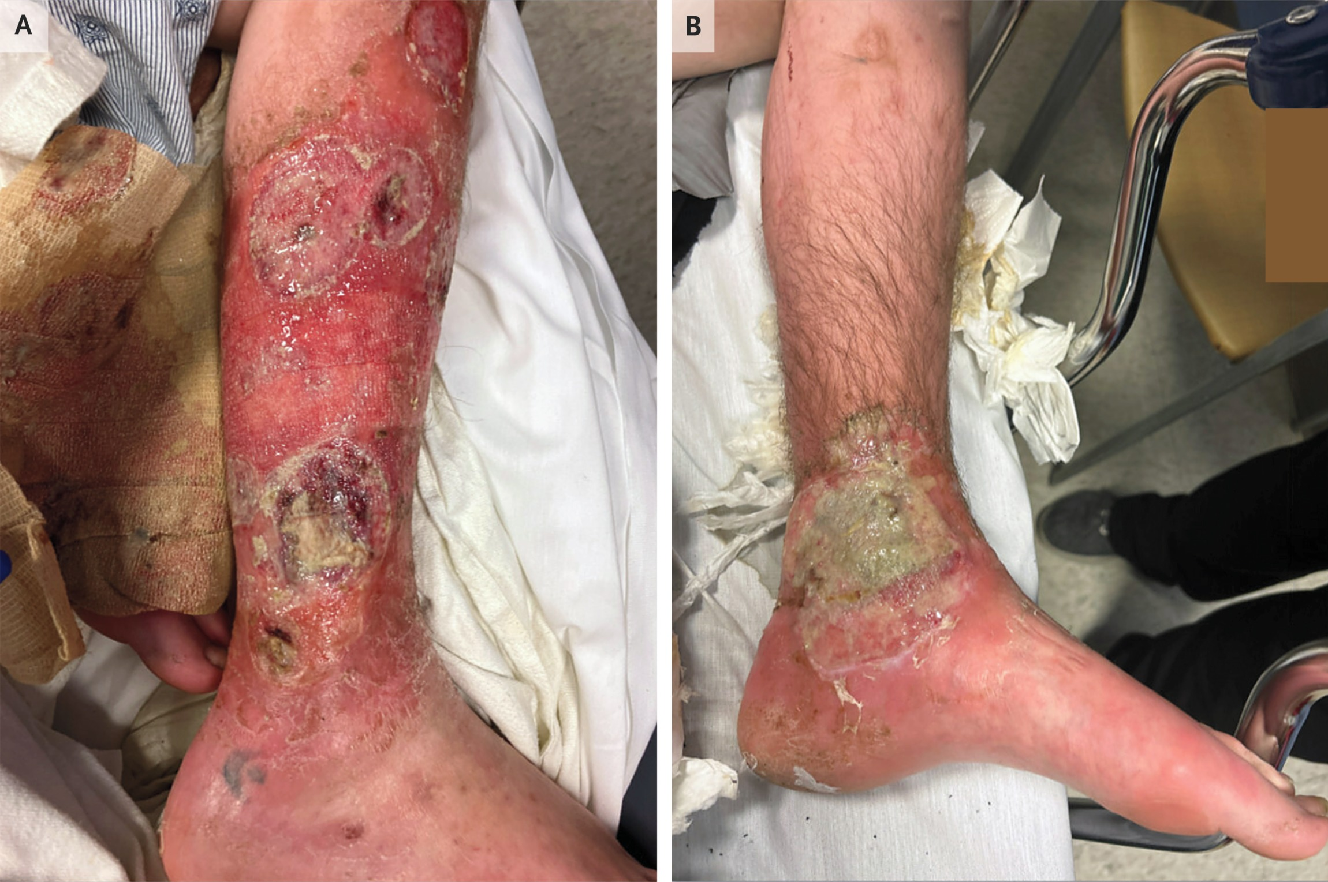
Purulent Wounds in the Legs.
Wilson GA et al. N Engl J Med2026;394:589-595
Notes:
Figure 1 Purulent Wounds in the Legs. Panel A shows the right leg, and Panel B shows the left leg.

Slide 4
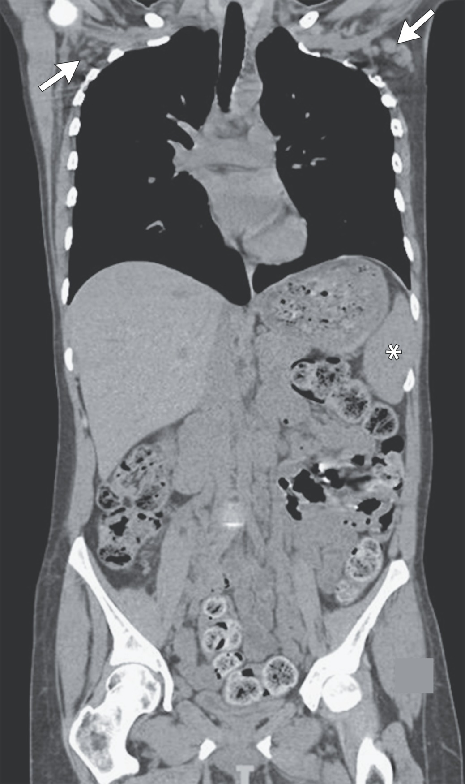
Coronal View of Computed Tomography (CT) of the Chest, Abdomen, and Pelvis with Intravenous Contrast.
Wilson GA et al. N Engl J Med2026;394:589-595
Notes:
Figure 2 Coronal View of Computed Tomography (CT) of the Chest, Abdomen, and Pelvis with Intravenous Contrast. The scan revealed bilateral axillary lymphadenopathy (arrows). Splenomegaly (asterisk) was also noted but is better visualized on other sections.

Slide 5
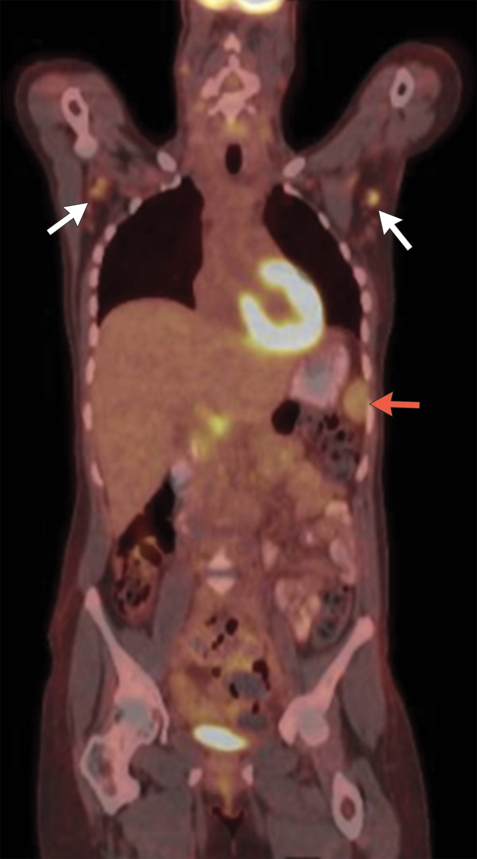
Coronal View of Positron-Emission Tomography–CT.
Wilson GA et al. N Engl J Med2026;394:589-595
Notes:
Figure 3 Coronal View of Positron-Emission Tomography–CT. The scan revealed ¹⁸F-fluorodeoxyglucose (FDG)–avid bilateral axillary lymphadenopathy (white arrows). An enlarged spleen with increased FDG intensity was partially visualized (red arrow).

Slide 6
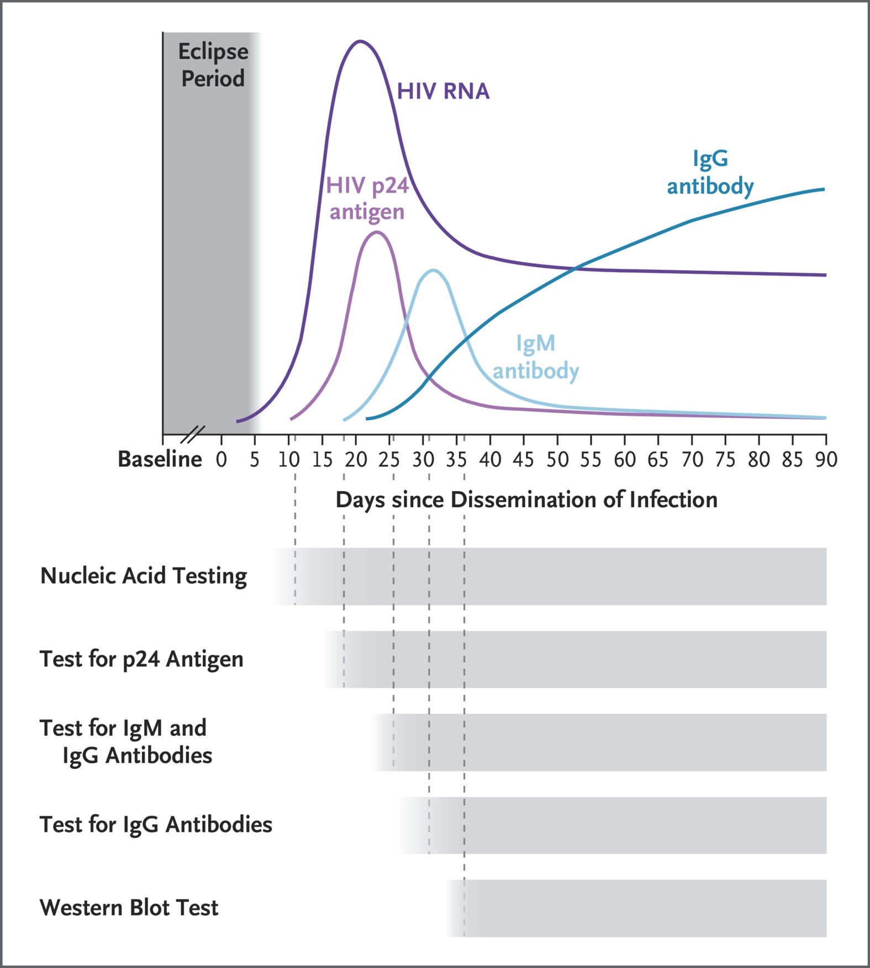
Viral and Immune Dynamics of Human Immunodeficiency Virus (HIV) Infection.
Wilson GA et al. N Engl J Med2026;394:589-595
Notes:
Figure 4 Viral and Immune Dynamics of Human Immunodeficiency Virus (HIV) Infection. The time to reactivity for each diagnostic test is shown below the graph. Adapted from Saag.⁴

