Slide 1

Clinical Problem-Solving
Too Much of a Good Thing
Mark Wijnen, M.D., Ph.D., N. Chantal Peltenburg, M.D., Ph.D., Dieuwertje Augustijn, Ph.D., Margreet A.E.M. Wagenmakers, M.D., Ph.D., and Janneke G. Langendonk, M.D., Ph.D.
N Engl J Med
Volume 394(13):1326-1332
April 2, 2026

Slide 2
Summary
A 57-year-old man with a 3-day history of vomiting and progressive confusion was brought to the ED by his wife.
He reported generalized weakness and difficulty speaking and swallowing but no headache or fever.

Slide 3
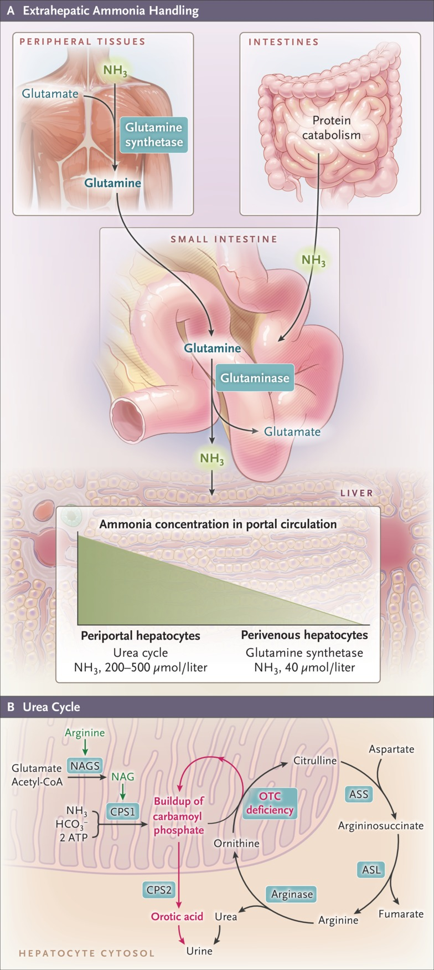
Extrahepatic Ammonia Handling and the Urea Cycle.
Wijnen M et al. N Engl J Med2026;394:1326-1332
Notes:
Figure 1 Extrahepatic Ammonia Handling and the Urea Cycle. As shown in Panel A, ammonia (NH₃) is produced during protein catabolism and in the intestines. In peripheral tissues, ammonia is incorporated with glutamate into glutamine by glutamine synthetase. In the small intestine, glutaminase releases ammonia and glutamate from glutamine. Ammonia enters the liver through the portal circulation, where periportal hepatocytes convert ammonia into urea through the urea cycle. Residual ammonia is taken up by perivenous hepatocytes and incorporated into glutamine again. As shown in Panel B, the urea cycle consists of five catalytic enzymes and one cofactor-producing enzyme. It incorporates two nitrogen atoms (one from ammonia and one from aspartate) into a single urea molecule. Deficiency of ornithine transcarbamylase (OTC), the second enzyme of the cycle, is the most common urea-cycle disorder. OTC deficiency results in accumulation of carbamoyl phosphate and overflow into the cytosol, where carbamoyl phosphate synthetase 2 (CPS2) converts it into orotic acid, which is detectable in the urine. ASL denotes argininosuccinate lyase, ASS argininosuccinate synthase, CoA coenzyme A, CPS1 carbamoyl phosphate synthetase 1, HCO₃⁻ bicarbonate, NAG N-acetylglutamate, and NAGS N-acetylglutamate synthase.

Slide 4
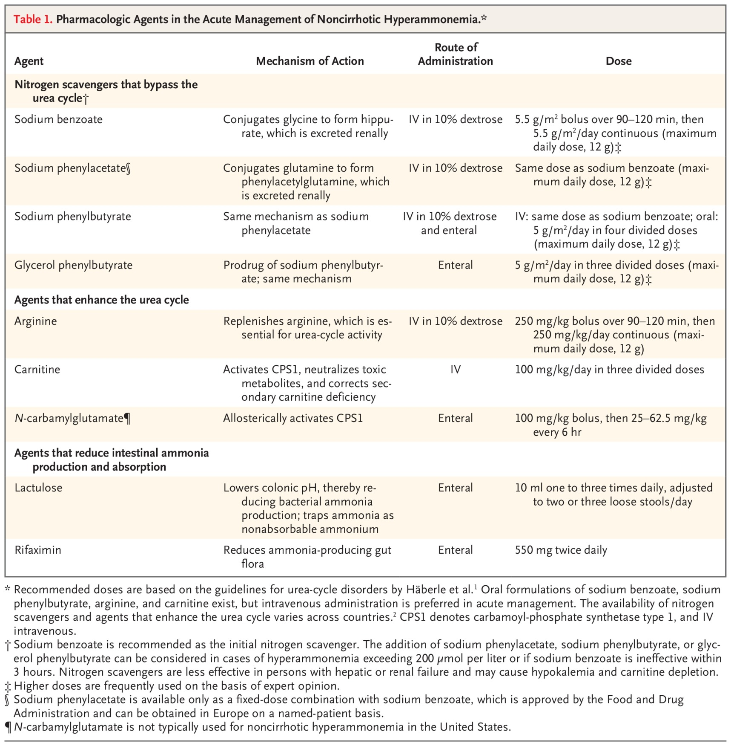
Pharmacologic Agents in the Acute Management of Noncirrhotic Hyperammonemia.
Wijnen M et al. N Engl J Med2026;394:1326-1332
Notes:
Table 1 Pharmacologic Agents in the Acute Management of Noncirrhotic Hyperammonemia.

