Slide 1

Case Records of the Massachusetts General Hospital
Case 22-2025: A 19-Year-Old Woman with Seizurelike Activity and Odd Behaviors
Judith A. Restrepo, M.D., Amirkasra Mojtahed, M.D., Leah W. Morelli, M.D., Nagagopal Venna, M.D., and Gulisa Turashvili, M.D., Ph.D.
N Engl J Med
Volume 393(5):488-496
July 31, 2025

Slide 2
Summary
A 19-year-old woman with a history of depression and anxiety symptoms was admitted to the hospital because of seizure, abnormal behavior, and disorganized thoughts.
MRI of the head was normal.
A diagnosis was made.

Slide 3
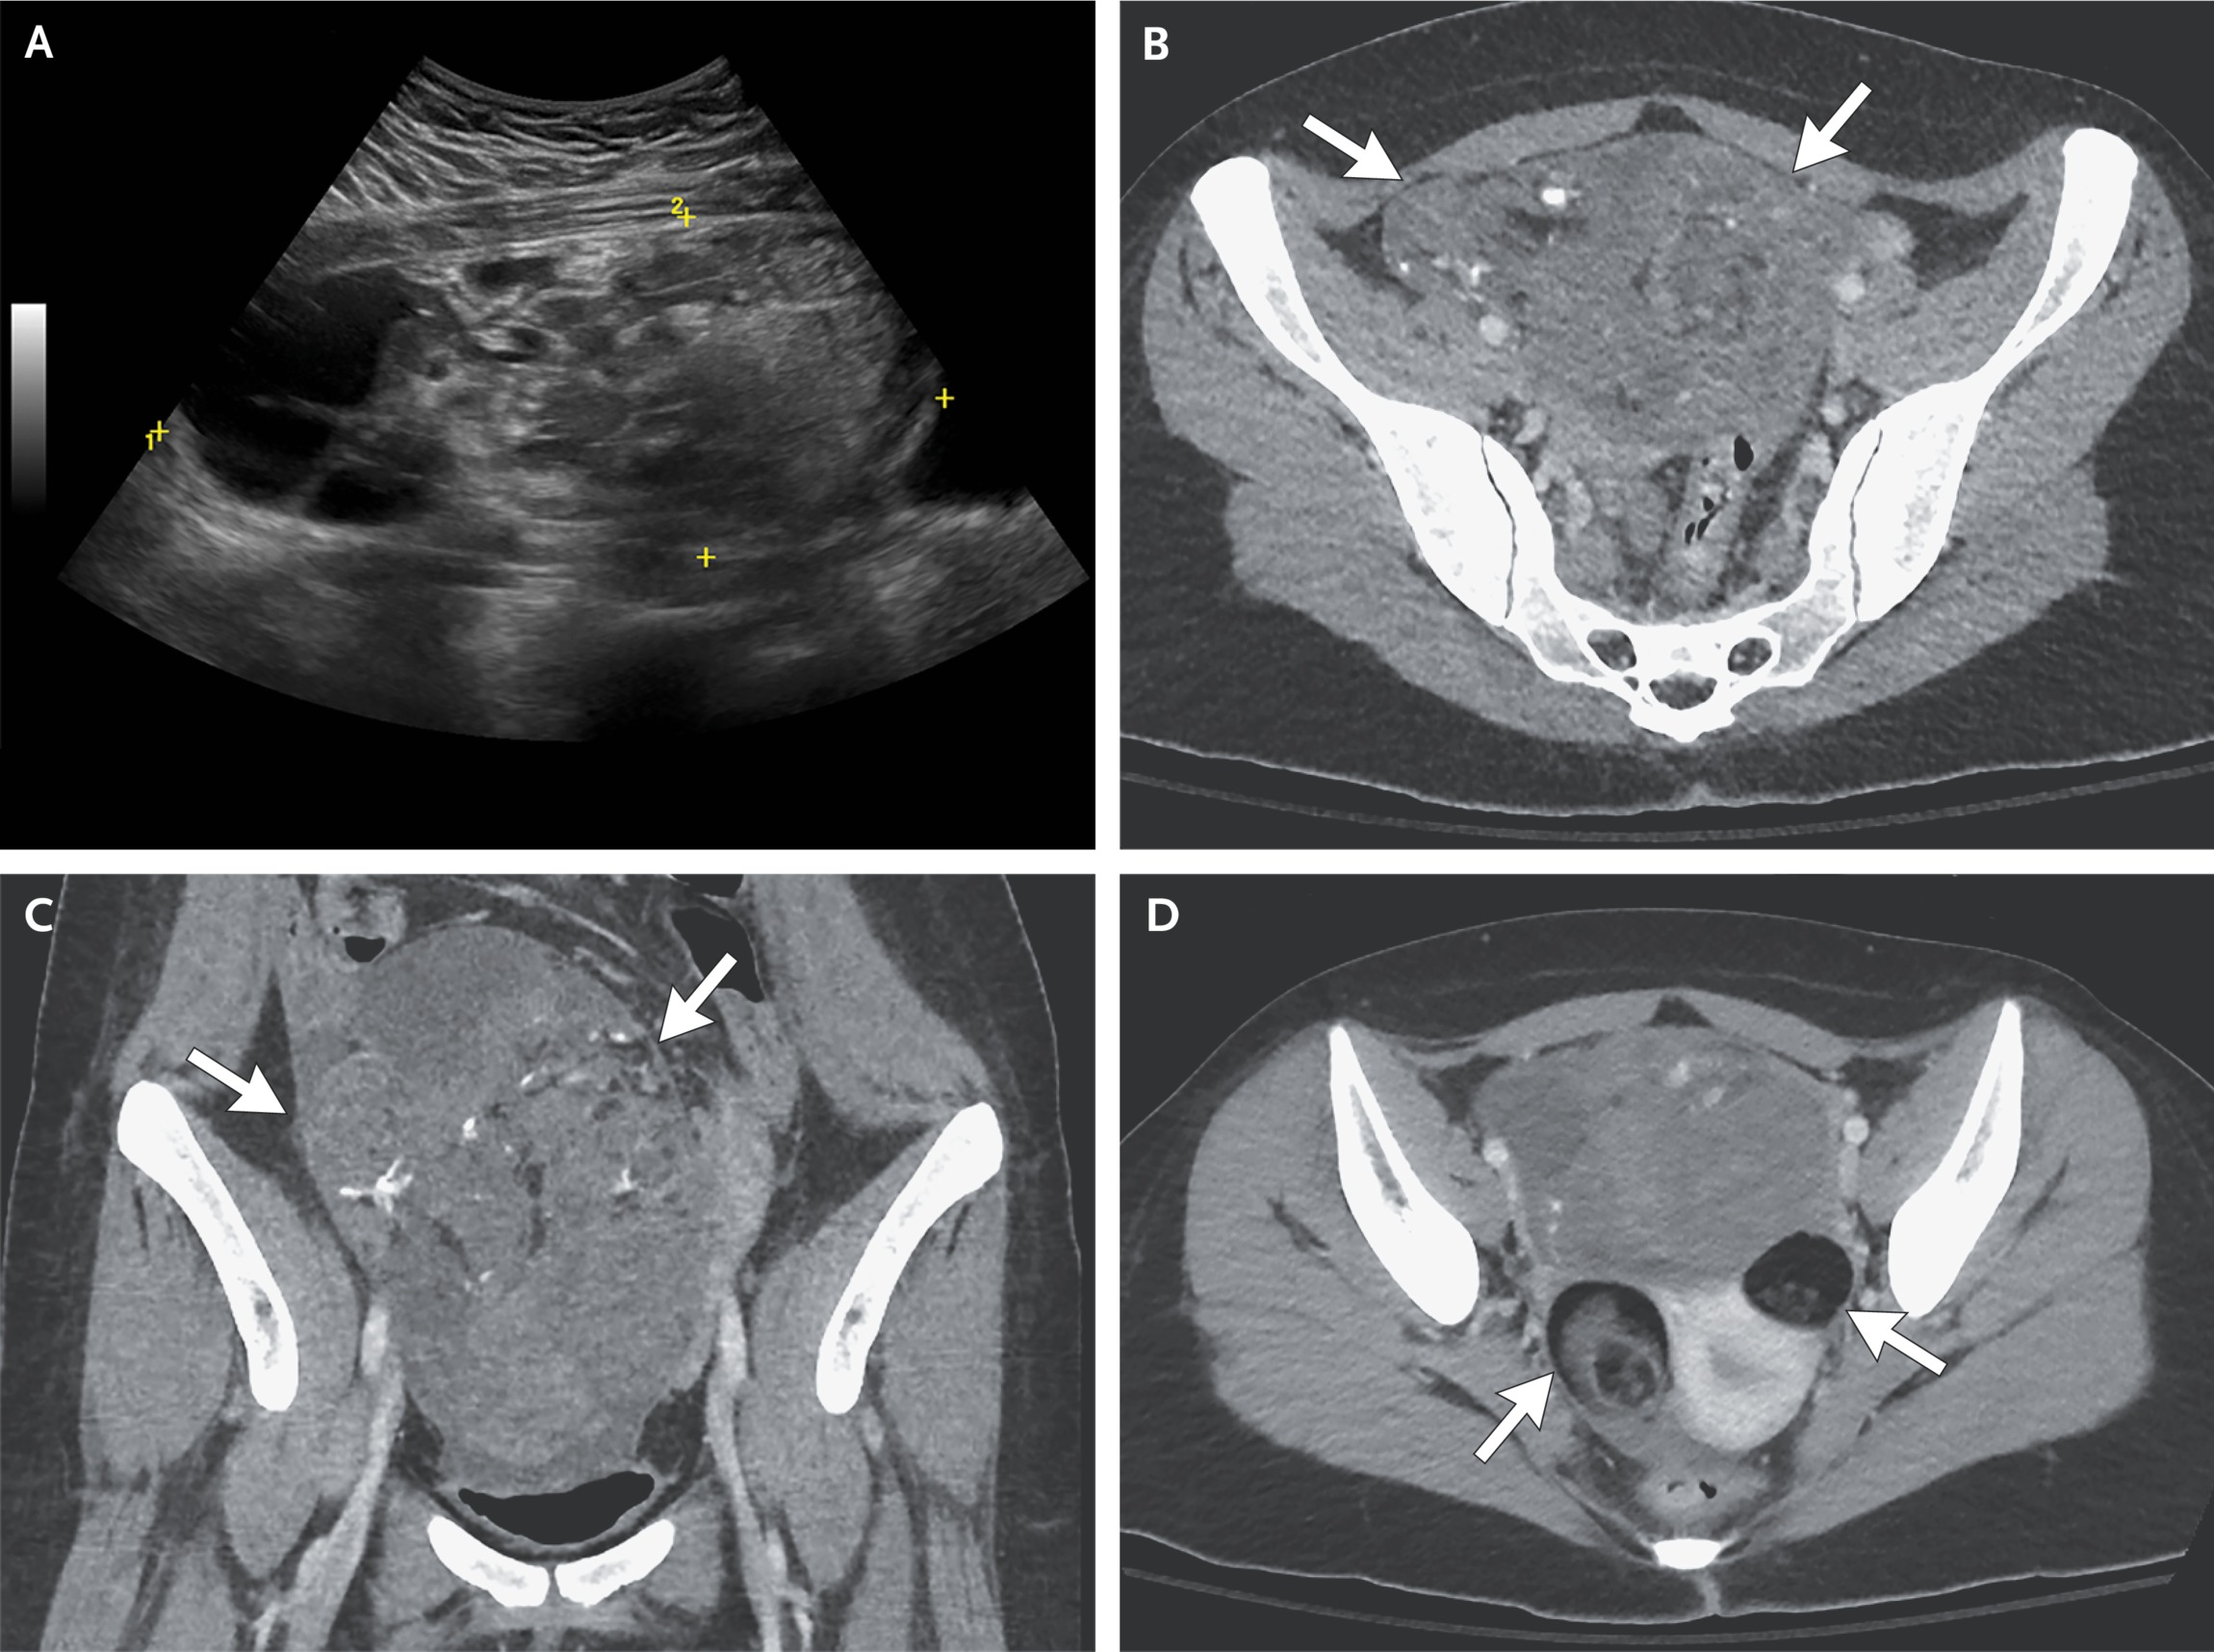
Imaging Studies of the Abdomen and Pelvis.
Restrepo JA et al. N Engl J Med2025;393:488-496
Notes:
Figure 1 Imaging Studies of the Abdomen and Pelvis. A transabdominal ultrasound image of the pelvis (Panel A) shows a 17-cm heterogeneous mass with mixed echogenicity in the right adnexa. Axial (Panel B) and coronal (Panel C) CT images of the abdomen and pelvis show a 17-cm heterogeneous mass in the midline of the pelvis containing fat, calcifications, and fluid and soft-tissue attenuation (arrows). An axial image of the pelvis (Panel D) taken at a more inferior level shows bilateral adnexal masses that contain fat and soft-tissue elements (arrows) and are more homogeneous than the larger mass.

Slide 4
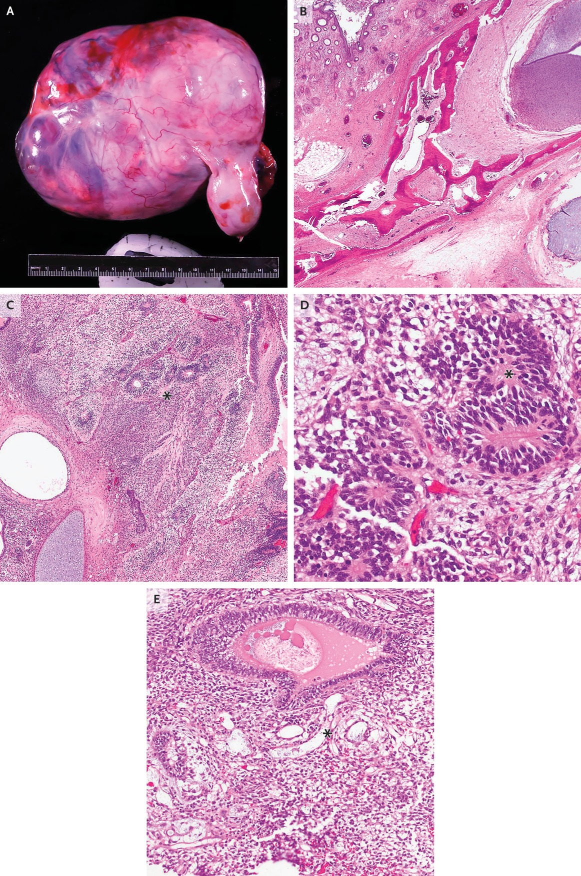
Left Salpingo-Oophorectomy Specimen.
Restrepo JA et al. N Engl J Med2025;393:488-496
Notes:
Figure 2 Left Salpingo-Oophorectomy Specimen. A photograph of the left ovarian mass shows a tan-white and diffusely nodular external surface (Panel A). Hematoxylin and eosin staining of a section of a mature teratoma specimen obtained from the left ovary (Panel B) shows tissue composition derived from all three germ layers, including the ectoderm (keratinizing squamous epithelium and skin adnexal structures), mesoderm (bone and adipose tissue), and endoderm (intestinal epithelium). Hematoxylin and eosin staining of a specimen of the immature teratoma from the left ovary (Panel C) shows tissue composed of diffuse sheets, primitive tubules, and pseudorosettes and rosettes of immature neuroepithelium (Panel C, asterisk); high-grade cytologic atypia with brisk mitotic activity within immature neuroepithelium (Panel D, asterisk) was present, as was a yolk-sac tumor component comprising anastomosing channels and variably sized cysts lined by primitive-appearing cells (Panel E, asterisk). The immature teratoma was approximately 70% of the overall tumor volume, and the yolk-sac tumor was approximately 30% of the overall tumor volume.

Slide 5
Final Diagnosis
Malignant mixed germ-cell tumor and anti–NMDA receptor encephalitis.

