Slide 1
JBI EBP Database & Searching on Ovid
Ovid Training Team
2021

Slide 2

Learning Objectives
JBI overview
Subject area nodes
Publication types
JBI database field guide
JBI Main search page
JBI Basic search mode
JBI Automated alerts
JBI Resources
JBI Newsletter
JBI tools
Ovid Support

Slide 3





JBI: a snapshot
WHO?
: a leading global EBP organisation
WHAT?
: evidence + education + software
WHERE?
: across 40+ countries
HOW?
: in partnership with experts across the world
WHY?
: to improve health outcomes
Notes:
The JBI Collaboration (JBIC) is the engine that drives the JBI’s worldwide effort to promote and support the use of the best available evidence to inform decisions made at the point of care. JBI collaborates with the Centres of Excellence and Affiliated groups in all regions of the world. Collectively, these Collaborating Entities are known as the JBI Collaboration (JBIC).
The JBIC is the largest global collaboration to integrate evidence-based healthcare within a theory-informed model that brings together academic entities with hospitals and health systems.

Slide 4

JBI Product Framework
JBI EBP Database
JBI Journal Collection
JBI Software Suite

Slide 5
JBI Evidence Based Practice Database
The JBI EBP Database is an online resource that includes high quality, relevant, up to date evidence-based information and guidance for health professionals to inform decisions made at the point of care.
Covering a wide range of medical, nursing, and allied health specialties, the JBI EBP Database includes 5000+ EBP resources that have been analysed and appraised by global expert reviewers.
Notes:
Covers a wide range of medical, nursing, and allied health specialties.
Includes over 5000 EBP resources that have been analysed & appraised by expert reviewers.
Enables health professionals and policymakers to integrate the best available evidence into practice.

Slide 6

JBI EBP Database Subject Area Nodes
Aged Care
Burns Care
Cancer Care
Cardiovascular Care
Chronic Disease
Diagnostic Imaging
Emergency and Trauma
General Medicine
Health Management and Assessment
Infection Control
Mental Health
Midwifery Care
Paediatrics
Rehabilitation
Renal Care
Surgical Services
Tropical & Infectious Diseases
Wound Healing & Management
Notes:
Each node of JBI is supported by an Expert Reference Group and a Corresponding Reference Group (external experts).
Node contents are designed to meet the needs of service providers, health professionals, GPs, medical directors, resident nurses and case workers.
Nodes may be used as a part of a search strategy or used as limits to focus the search results.

Slide 7




5 full text publication types
Guidelines to implement in clinical practice
  1. Evidence Summaries
  2. Recommended Practices
  3. Best Practice Information Sheets
Detailed documents for further investigation
  4. JBI Systematic Reviews
  5. JBI Systematic Review Protocols
7
Notes:
There are 5 full text guidelines available in JBI
3 of the guidelines represent those that can be implemented into the clinical practice.
2 are the detailed documents for further investigation of the background and information

Slide 8

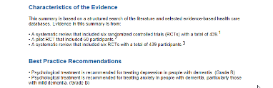
Evidence Summaries
A JBI Evidence Summary (JBI ES) is a comprehensive, concise overview of the best available evidence for a clinical topic.
Each Summary includes a clinically focused question; a brief summary of key points of evidence; an overview of the quality and level of evidence and a series of key recommendations informed by the evidence.
http://ospguides.ovid.com/OSPguides/jbidb.htm
JBI EBP Database & JBI Tools
8
Notes:
Evidence Summaries are critical resources for evidence-based practice. Each Evidence Summary is a comprehensive yet concise overview of the evidence for a specific clinical topic which includes a clinically focused question, a brief summary of key points of evidence, an overview of the quality and level of evidence, a series of key recommendations informed by the evidence, and each is fully referenced. These can be used by clinicians to inform decision making preparing for a care practice that might be new to them, or infrequently used, when they are unsure of what the latest evidence is on a topic, or to gain knowledge that supports discussion with patients and their families. Evidence summaries can also be used in clinical case reviews, care planning, staff education, shared with patients for patient education, and used to guide decision making.

Slide 9

Recommended Practices
JBI Recommended Practices (JBI RP) are evidence-based procedures, linked to a JBI ES, that provide a clear description of steps and processes for a wide range of care procedures.
JBI Recommended Practices are developed by an expert clinical review panel to confirm clinical relevance and currency.
JBI EBP Database & JBI Tools
9
Notes:
An Evidence-Based Recommended Practice is usually a guideline which assists a patient or a patient group.
The advice in a recommended practice comes from the summary of the research and recommendations within an Evidence Summary – the two items are connected in the recommended practice PDF.
-> These documents describe recommended processes and procedures for common treatments, including equipment list and Evidence Summary.
Students benefit from this resource because it provides a high-quality database of interventions common to clinical practice which they can review, revise and learn from. Clinicians, quality managers, and organisations benefit when comparing their own organisations standards and care procedures against the JBI Evidence-based Recommended Practices to assist with the review of internal health care facility procedures. There are huge cost savings from using the JBI resources, with direct savings on staff time, salaries, review processes and the resources required to develop and maintain procedures internally.
JBI RP provide clinicians and quality managers with confidence that the evidence-based procedures will enable them to:
• Standardize practice in line with the best available evidence, reducing inappropriate variation and improving patient safety
• Make clinical decisions and facilitate delivery of care based on the best available evidence
• Implement quality standards for practice that will improve the quality of care provided
• Compare their organization’s standards and care procedures against the JBI evidence-based RP to assist with the review of internal procedures
• Garner cost savings, with direct savings on staff time, salaries, review processes and the resources required to develop and
maintain procedures internally.

Slide 10

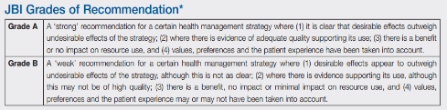
Best Practice Information Sheets
A JBI Best Practice Information Sheet (JBI BPIS) is a high-quality summary of a single JBI Systematic Review.
JBI BPIS take the key evidence from large, complex systematic reviews and reframe it in an easy to read, readily accessible format – designed for clinicians at the point of care to be able to quickly access, read and use the evidence, including recommendations for practice and algorithms that guide clinical decision making.
Grades of Recommendation used: A=Strong Evidence; B=Weak Evidence.
JBI EBP Database & JBI Tools
10
Notes:
Best Practice Information Sheets are easy to read and understand guidelines on broad topics based on results and recommendations of Systematic Reviews (max 6 pages); JBI Recommendation Grades A-C; easily disseminated, provides busy health professionals with access to key issues and recommendations collected from a large volume of material.
The JBI Best Practice series is optimally used by clinicians and students who would otherwise not have good access to evidence from systematic reviews, either to inform clinical care provision or enhance study and personal professional learning.

Slide 11

Systematic Reviews
Systematic Reviews:
  Are an explicit and transparent method for identifying, evaluating and summarizing the results of individual studies (called primary studies) on the outcomes of a determined health intervention.
  https://www.jbisumari.org/
  +500 Systematic Reviews available
Systematic Review Protocols:
    A document outlining the objectives for future Full Systematic Reviews.
    +1100 Protocols available
JBI EBP Database & JBI Tools
11
Notes:
Systematic reviews (or protocols) written by the members of the institute. These systematic reviews often lead to the production of other types of publications. These documents are not often used to guide patient treatment but are useful to see how allied health personnel have participated in research.
Analysis of all literature (evidence). Extensive review of clinical trials - develop a question; develop a strategy; appraise quality of each paper; exclude poor quality papers; extract & synthesise findings of included papers; implications for research & practice.

Slide 12
Recent Updates
1000+ new documents
Wider range of topics
Remodelled, dynamic content
Methods will be published to promote scientific transparency & demonstrate rigour
All content updated every 12-18 months

Slide 13


JBI Journal Collection
JBI Evidence Synthesis
(formerly the JBI Database of Systematic
Reviews and Implementation Reports)
JBI Evidence Implementation
(formerly the International Journal of
Evidence Based Healthcare)
Notes:
JBI Evidence Synthesis relaunch: January 2020
About: JBI Evidence Synthesis is a multidisciplinary journal that publishes high-quality research that provides the best available evidence to inform health policy and practice through the science and conduct of research syntheses.
Journal scope: The journal publishes systematic and scoping review protocols, diverse types of systematic reviews and scoping reviews that apply the methodology and methods developed by JBI.
JBI Evidence Implementation relaunch: September 2020
About: An international, peer reviewed journal that publishes manuscripts encompassing evidence implementation in healthcare.
Journal scope: Publishes JBI Implementation Case Studies & manuscripts that address the science & practice of research implementation into policy and practice, as it relates to issues of context, facilitation and evaluation.

Slide 14


JBI Software Suite
Notes:
JBI SUMARI (System for the Unified Management of the Assessment and Review of Information) is a software program designed to assist in the conduct of JBI systematic reviews. JBI SUMARI is a web-based application. It allows users to conduct systematic reviews following the JBI approach as well as the ability to create non-JBI reviews.
PACES is JBI’s web-based application for implementing evidence into practice and quality improvement. It will assist health professionals and those in quality improvement to improve their performance inline with the best available evidence.

Slide 15
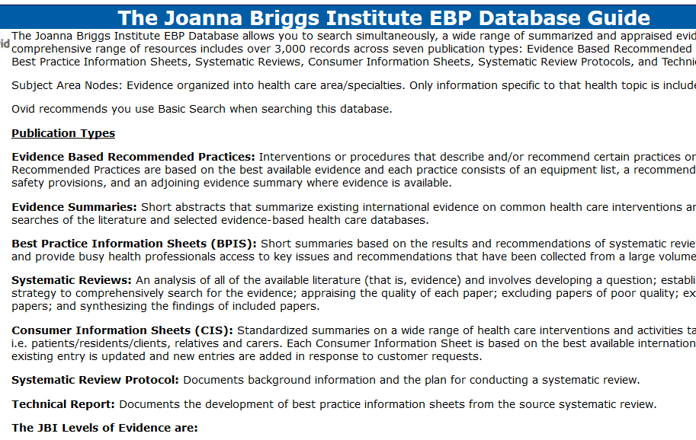
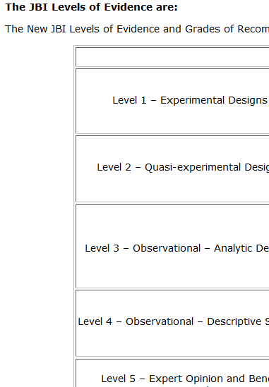
JBI Database Field Guide
http://ospguides.ovid.com/OSPguides/jbidb.htm
15
Notes:
The database field guide provides all you need to know about the DB including, the types of evidence grading/system used to determine the strength of the evidence referenced.

Slide 16



JBI on Ovid®: JBI EBP Tools

